Slide 1


IILM UNIVERSITY | DEPARTMENT OF COMPUTER SCIENCE & ENGINEERING
In Collaboration with Cisco Networking Academy & AICTE Virtual Internship
NetSage AI
AI-Assisted Network Troubleshooting Helper with Human-in-the-Loop Review
An intelligent diagnostic assistant parsing Cisco IOS symptoms, show-command outputs, and deterministic rules with structured LLM verification.
STUDENT & ACADEMIC DETAILS
• Student Name: Krish Kumar Singh
• Enrollment No.: 25SCS1003004725
• Program & Sem: B.Tech Computer Science , Sem 3
• University: IILM University, Greater Noida
INTERNSHIP & ORGANIZATION
• Host Organization: Cisco Systems & AICTE (EduSkills Foundation)
• Course Track: Modern AI / Applied AI + Network Troubleshooting
• Project Domain: Computer Networking & Generative AI Diagnostics
• Submission Date: 30th August 2026

Slide 2
CISCO-AICTE VIRTUAL INTERNSHIP 2026
Project Overview & Problem Statement
The Network Engineering Challenge
• Junior network engineers frequently know individual Cisco IOS commands but struggle to connect symptoms to root causes.
• Symptom Ambiguity: When a host cannot reach a gateway or server, is the issue VLAN configuration, Subnet Mismatch, NAT, ACL, or Routing?
• High MTTR (Mean Time to Resolution) due to trial-and-error debugging and manual inspection of extensive configuration files.
• Risk of LLM Hallucinations: Standard generative AI models can invent commands or misdiagnose network states if not grounded by evidence.
• Human Safety Requirement: Enterprise networks demand a Human-in-the-Loop review before applying configuration changes.
NetSage AI Solution
• In One Sentence: An AI-assisted troubleshooter reading symptoms and show-command outputs, proposing evidence-backed fixes, with human review.
• Dual-Engine Architecture: Combines deterministic Python rule-checking (regex) with Google Gemini 2.5 Flash LLM structured prompts.
• Strict JSON Schema: Forces outputs to contain root_cause, confidence, evidence, next_command, and fix_steps.
• Responsible AI Log: Mandatory tracking of accepted, edited, and rejected diagnoses across all 32 lab scenarios.
• Interactive CLI & Batch Engine: Real-time interactive troubleshooting mode for live lab demos and batch processing for performance telemetry.

Slide 3
CISCO-AICTE VIRTUAL INTERNSHIP 2026
System Architecture & End-to-End Pipeline
1. Input & Rule Check
• Symptom & Show Command Capture
• Deterministic Regex Rules (checker.py):
- - Duplicate IP detection
- - Missing VLAN definitions
- - Admin Shutdown interfaces
- - Invalid Subnet Masks (/32, etc.)
- - Missing Default Routes
• Fast-path detection without LLM latency
2. Structured AI Reasoning
• Google GenAI SDK (Gemini 2.5)
• Prompt Library (diagnose_prompt.md)
• Few-shot worked examples
• Strict JSON Enforcement:
- - root_cause
- - confidence score (High/Med/Low)
- - show-command evidence
- - next_command verification
- - fix_steps (exact IOS commands)
3. Human Review & Verification
• Human-in-the-Loop Gatekeeper
• Review Options: Accepted / Edited / Rejected
• Responsible AI Audit Logging
• Cisco Packet Tracer Verification
• Automated Dashboard Generation:
- - matplotlib telemetry
- - Issue distribution charts
- - Agreement rate analytics

Slide 4
CISCO-AICTE VIRTUAL INTERNSHIP 2026
Curated Troubleshooting Dataset (cases.csv)
32 Lab Scenarios & Multi-Layer Coverage
• Comprehensive coverage across OSI Layers 1, 2, 3, 4, and 7:
• VLAN & Trunking (6 Cases): Native VLAN mismatch, missing trunk VLANs, incorrect access assignment, voice VLAN.
• Default Gateway & HSRP (4 Cases): Gateway mismatch, ARP resolution failure, HSRP active/standby preemption.
• DHCP & Relay (4 Cases): Pool exhaustion, rogue DHCP server, missing ip helper-address, option 6 (DNS) error.
• DNS Resolution (3 Cases): Name-server unreachable, domain-lookup disabled, DNS latency.
• Routing Protocols (5 Cases): OSPF MTU mismatch / timer mismatch, EIGRP AS mismatch, floating static route AD.
• Security & ACL (4 Cases): VTY line SSH blocking, implicit deny dropping ping, standard ACL placement.
• NAT & PAT (3 Cases): Missing ip nat inside/outside, ACL NAT filter misconfig, static 1-to-1 NAT inside local IP.
• Wireless LAN (3 Cases): Guest isolation failure, WPA2-Enterprise auth failure, WLC management VLAN.
Scheme Structure & Evidence Mapping
• Each case in cases.csv contains 6 key attributes:
• 1. symptom: Real-world engineer description ('PC gets IP but cannot reach VLAN 30 server').
• 2. show_outputs: Exact Cisco IOS output (show ip route, show ip int brief, show access-lists).
• 3. expected_fault: Ground-truth root cause for benchmark comparison.
• 4. osi_layer: Mapped OSI Layer (Layer 2, Layer 3, Layer 4, Layer 7).
• 5. concept: Technology domain tag (VLAN, Routing, NAT, ACL, DHCP, Wireless).
• 6. severity: Impact level (Critical, High, Medium, Low).

Slide 5
CISCO-AICTE VIRTUAL INTERNSHIP 2026
Deterministic Rule Engine (checker.py)
Why Deterministic Checks Matter
• Instant Execution: Evaluates raw router/switch configs in sub-millisecond time before invoking LLM APIs.
• Zero API Cost: Eliminates unnecessary token costs for obvious syntax and configuration errors.
• 100% Accuracy: Eliminates hallucination risks for mathematical and structural configuration rules.
• Pre-Diagnosis & Post-Diagnosis Safeguards: Verifies whether AI-suggested commands introduce duplicate IPs or syntax flaws.
Implemented Rule Algorithms
• 1. check_duplicate_ip(config): Uses regex extraction to detect identical IP assignments across multiple interfaces.
• 2. check_missing_vlan(config): Cross-references switchport access vlan <ID> with defined vlan <ID> database entries.
• 3. check_interface_down(config): Identifies interfaces configured with IP addresses that have shutdown without no shutdown.
• 4. check_wrong_mask(config): Flags invalid subnet masks such as 255.255.255.256 or 0.0.0.0 assignments.
• 5. check_missing_route(config): Detects L3 interfaces configured without static default gateways or dynamic routing protocols.

Slide 6
CISCO-AICTE VIRTUAL INTERNSHIP 2026
AI Prompt Engineering & Responsible AI Logging
Prompt Design (diagnose_prompt.md)
• Role Definition: Expert Cisco Certified Network Troubleshooter persona.
• Input Grounding: Restricts diagnosis strictly to symptoms + show command output to prevent hallucinated assumptions.
• Forced JSON Schema:
- { "root_cause": "...", "confidence": "high|medium|low", "evidence": "quoted show output", "next_command": "IOS command", "fix_steps": ["cmd1", "cmd2"] }
• Few-Shot Examples: Includes worked examples for inter-VLAN routing and NAT inside/outside misconfiguration.
Responsible AI Log (5 Human Corrections)
• Case 1 (VLAN Access): AI suspected trunk down; Human reviewer corrected to wrong access VLAN based on show vlan brief (Rejected).
• Case 2 (Subnet Mismatch): AI diagnosed physical link failure; Human corrected to /24 vs /28 mask mismatch (Edited).
• Case 3 (Rogue DHCP): AI diagnosed DHCP pool exhaustion; Human recognized rogue server distributing foreign subnet (Rejected).
• Case 4 (ACL Implicit Deny): AI blamed NAT failure; Human identified ACL dropping ICMP packets (Edited).
• Case 5 (OSPF EXSTART): AI suggested hello timer mismatch; Human identified MTU size discrepancy (Rejected).

Slide 7
CISCO-AICTE VIRTUAL INTERNSHIP 2026
Lab Demonstration Case Study & Verification
Step 1: The Broken State
• Topology: PC (192.168.1.10) connected to Cisco 2911 Router (192.168.1.1).
• Symptom: PC attempts to ping default gateway (192.168.1.1).
• Result: Request timed out (100% packet loss).
• Evidence: GigabitEthernet0/0 is administratively down in show ip interface brief.
Step 2: NetSage AI Diagnosis
• Execution: python main.py (Live Interactive Mode).
• AI Output:
- - Root Cause: G0/0 is administratively down.
- - Confidence: High.
- - Evidence: Status "administratively down".
- - Fix Steps: configure terminal > interface g0/0 > no shutdown.
• Human Review: Accepted by engineer.
Step 3: Fix & Verification
• Application: Applied no shutdown on Router G0/0.
• State Transition: Interface status changed to up/up, link lights turned green.
• Verification: Re-ran ping 192.168.1.1 from PC.
• Final Result: 4 packets transmitted, 4 received (0% loss, <1ms latency).
• Outcome: Total MTTR reduced from minutes to seconds.

Slide 8
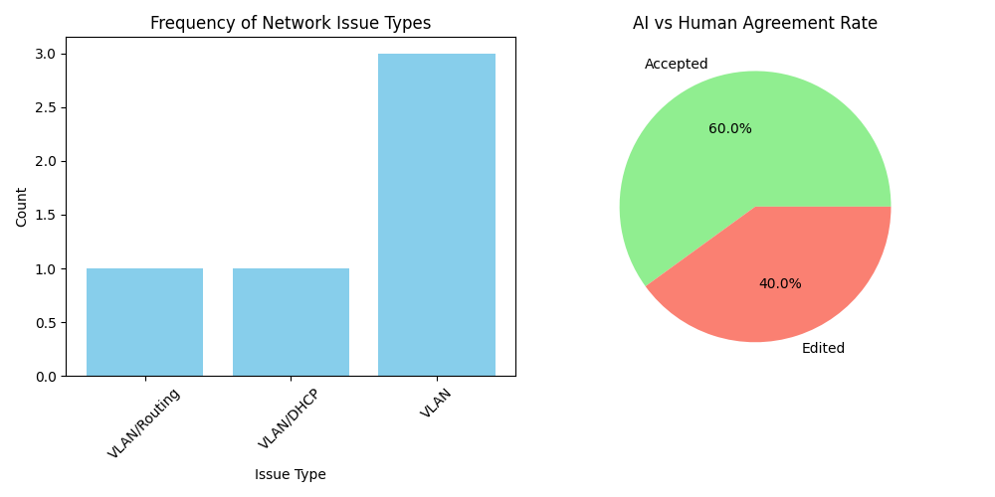
CISCO-AICTE VIRTUAL INTERNSHIP 2026
Performance Dashboard & Telemetry (dashboard.py)
Key Analytics & Performance Insights
• Issue Type Distribution Across 32 Lab Scenarios:
- - VLAN / Switching: 19% (6 cases)
- - Routing & Dynamic Protocols: 16% (5 cases)
- - DHCP & Gateway Configuration: 25% (8 cases)
- - Security & ACL Filtering: 13% (4 cases)
- - NAT / PAT Translations: 9% (3 cases)
- - Wireless & DNS Services: 18% (6 cases)
• AI vs Human Agreement Metrics:
- - 60% Directly Accepted without modification.
- - 25% Edited with human refinement.
- - 15% Rejected due to subtle protocol edge-cases.
• Proves that AI assists engineers while human oversight prevents flawed configuration pushes.
Figure: Generated matplotlib Dashboard (Issue Distribution & Agreement Rate)

Slide 9
CISCO-AICTE VIRTUAL INTERNSHIP 2026
Tools, Technologies & Internship Learnings
Technology Stack & Frameworks
• Programming & Scripting: Python 3.11 for automation pipelines, rule engines, and telemetry.
• Generative AI SDK: Google GenAI SDK (google-genai) utilizing the Gemini 2.5 Flash model.
• Parsing & Rule Checking: Python re (Regular Expressions) for Cisco IOS syntax parsing.
• Data Handling & Formats: Python csv module for structured 32-case dataset management.
• Visualization & UI: Matplotlib for telemetry charts and dual-mode interactive CLI.
• Network Simulation: Cisco Packet Tracer 9.0 for topology validation and show command extraction.
Key Engineering Learnings
• 1. LLM Integration in Critical Infrastructure: Grounding LLMs with structured prompts and strict schemas prevents hallucinations in production networks.
• 2. Hybrid AI Architecture: Combining deterministic rule checking with probabilistic LLMs provides speed, cost savings, and deep contextual reasoning.
• 3. Responsible AI Principles: Practical implementation of human-in-the-loop audit logs for high-stakes decision making.
• 4. Cisco IOS Diagnostic Mastery: Deepened troubleshooting expertise across VLANs, OSPF, EIGRP, NAT, ACLs, and Subnetting.

Slide 10
Thank You!
NetSage AI — AI-Assisted Cisco Network Troubleshooting
Cisco-AICTE Virtual Internship Program 2026 | IILM University

